Slide 1
Fundamentals of Statistical Testing
Recap, Z-scores, and Unusual Cats.
Dr. Martina Sladekova

Slide 2


Slide 3
Housekeeping

Slide 4

Register your Kahoot username:
https://canvas.sussex.ac.uk/courses/35783/quizzes

Slide 5

The R-Helpdesk is up and running:
https://canvas.sussex.ac.uk/courses/35783/pages/module-contacts

Slide 6
Where are we going?

Slide 7
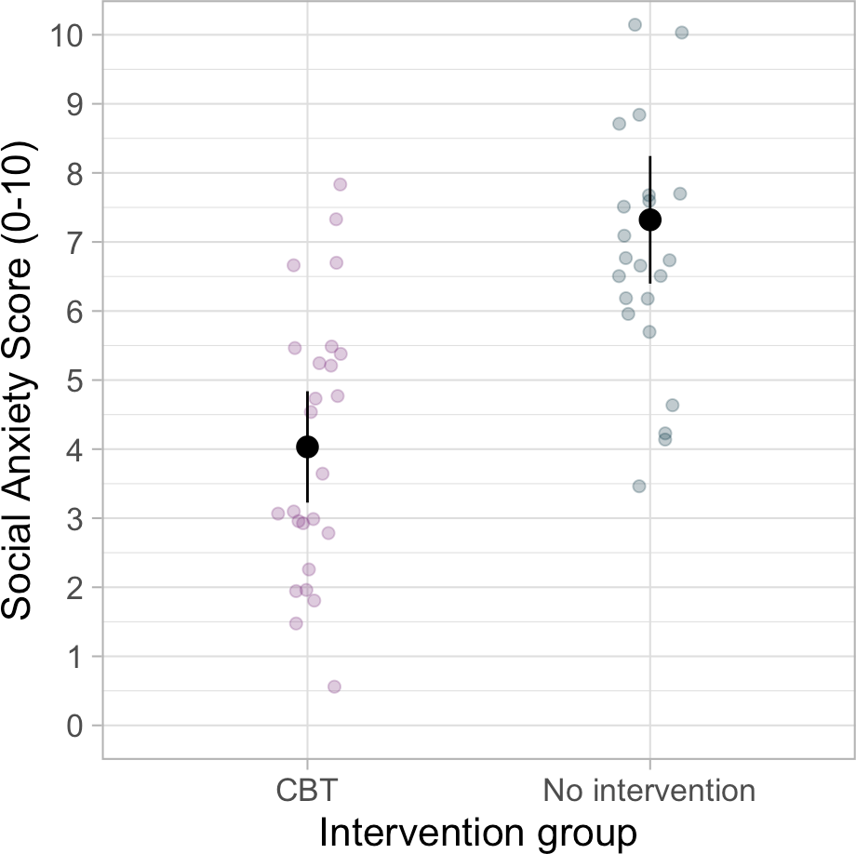
Research questions and hypotheses
We want to answer a research question or be able to make decision about a hypothesis
Research question:
Is CBT (Cognitive Behavioural Therapy) effective for treating social anxiety?
Hypothesis:
Participants who receive the CBT intervention will show lower social anxiety levels than participants who don’t receive an intervention.

Slide 9


Research questions:
Poll link:
linktr.ee/analysingdata

Slide 10
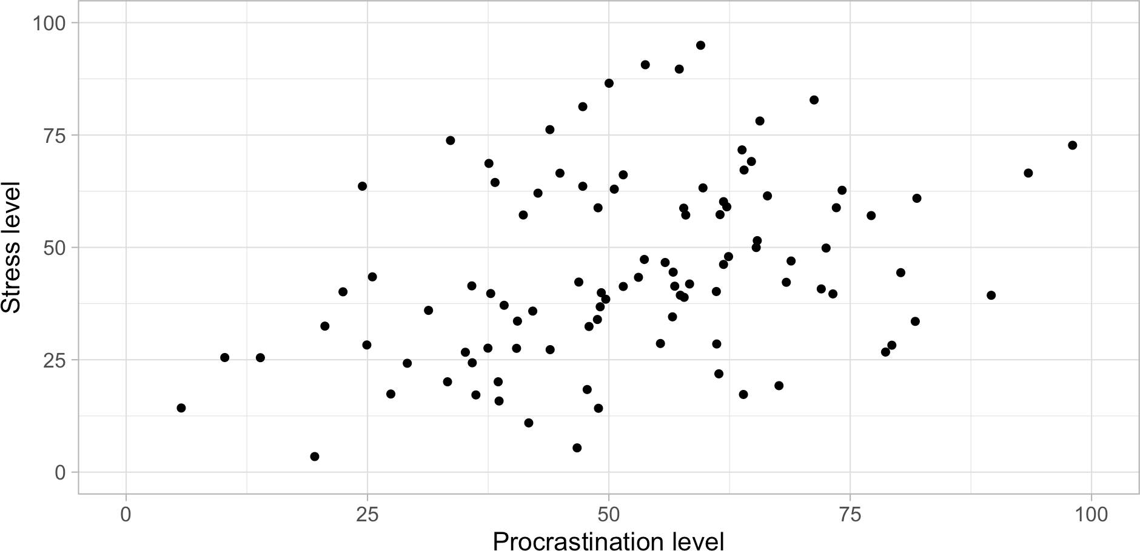
Research questions and hypotheses
Some other examples [made up data]:
Hypothesis: The more we procrastinate, the more stressed we feel.

Slide 11
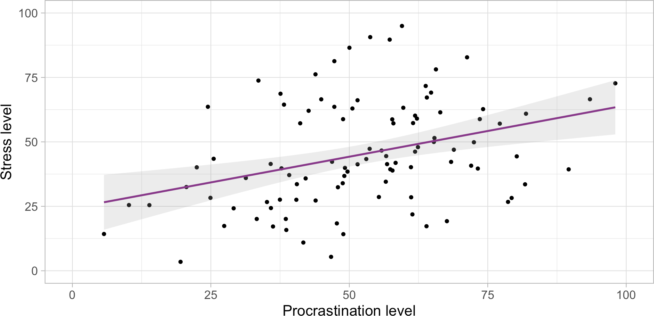
Research questions and hypotheses
Some other examples [made up data]:
Hypothesis: The more we procrastinate, the more stressed we feel.

Slide 12
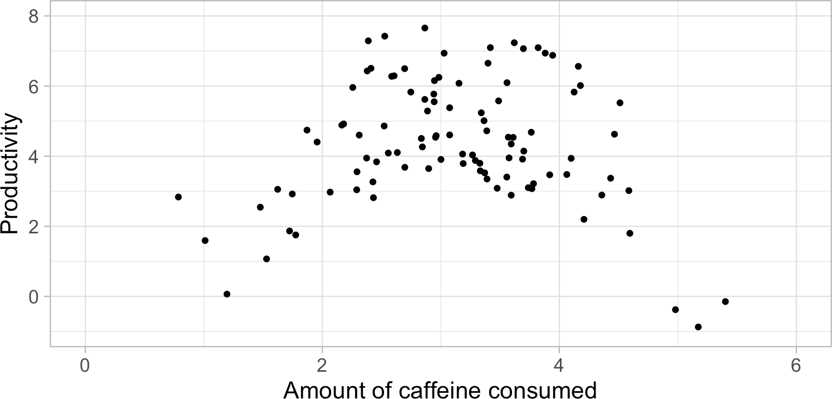
Research questions and hypotheses
Some other examples [made up data]:
Research question: Is there a relationship between caffeine consumption and productivity?

Slide 13
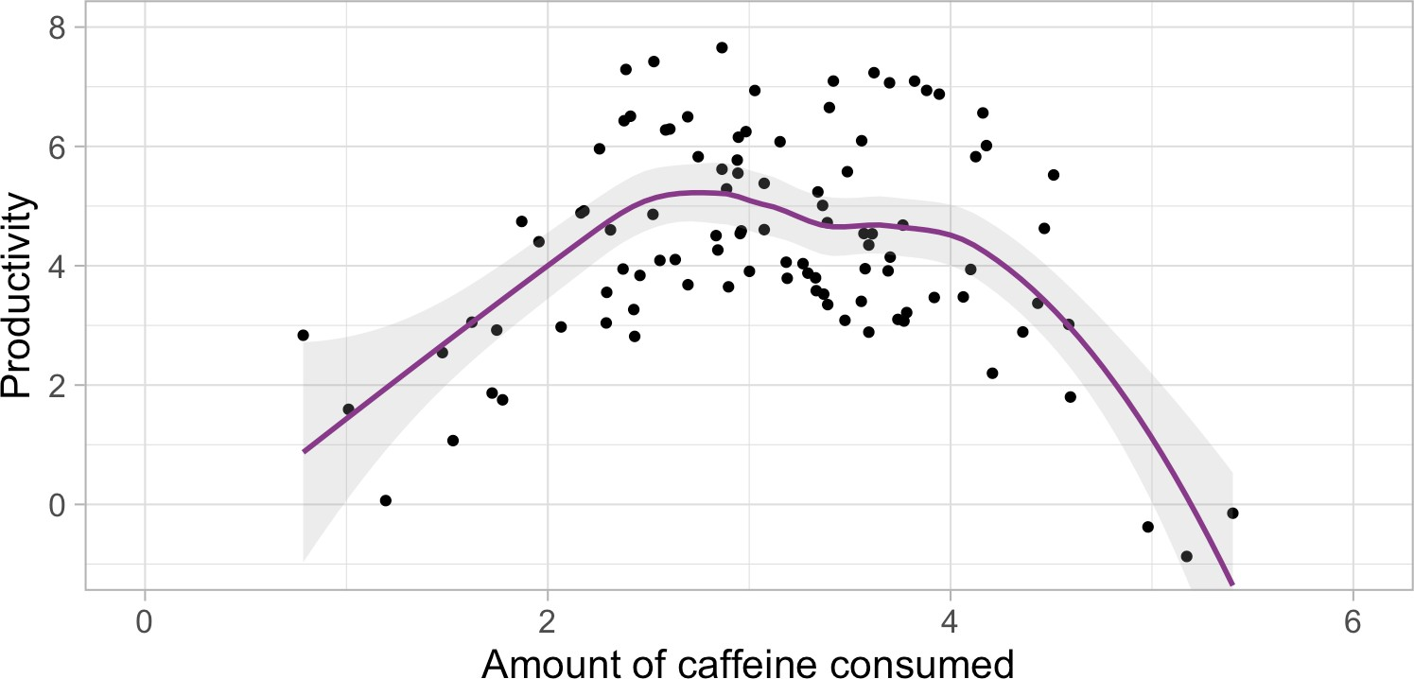
Research questions and hypotheses
Some other examples [made up data]:
Research question: Is there a relationship between caffeine consumption and productivity?

Slide 14
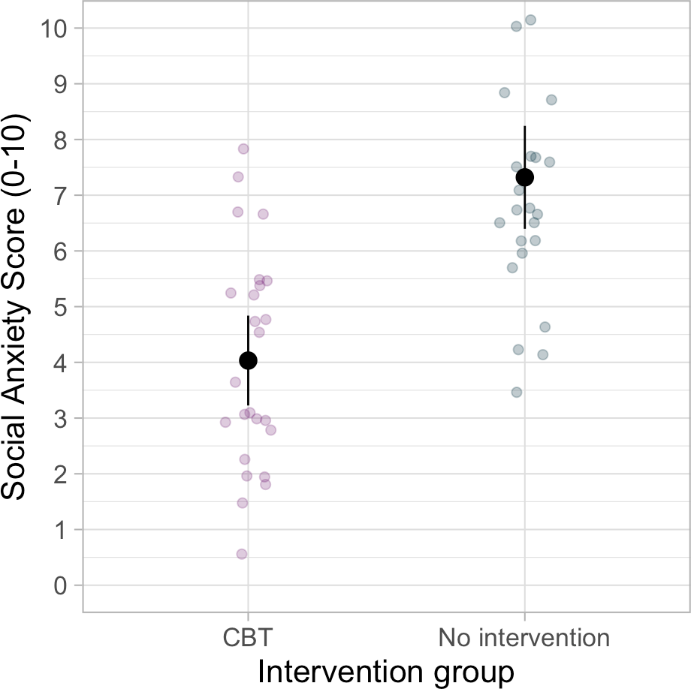
Research questions and hypotheses
Often the data will not show a clear cut difference
“p-value”:
a hypothesis testing tool
a value that we calculate to “formally” decide whether our hypothesis is supported
The next three weeks - building blocks of hypothesis testing

Slide 15
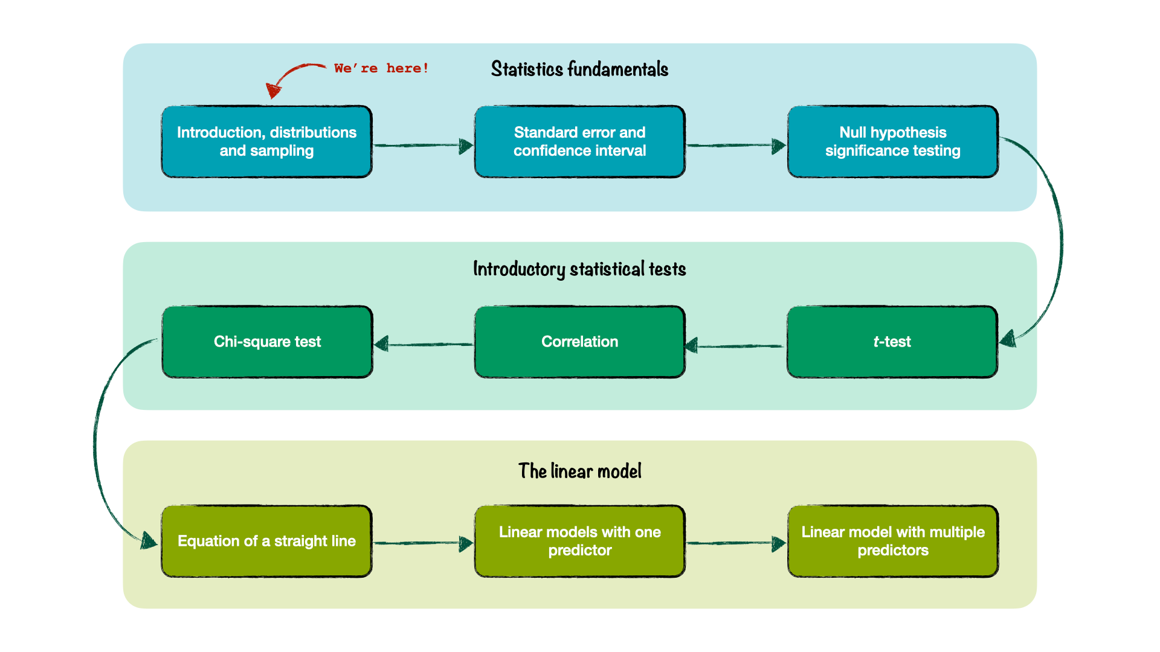
Analysing Data Roadmap

Slide 16
Where did we come from?

Slide 17
Quantitative research
In quantitative research, we often (but not always): Start with a theory,
Devise an experiment (or a cross-sectional study) to test that theory Collect the data
Describe our sample <- last term
Test hypotheses <- this term

Slide 18

A study
Forman and Leavens (2024) - The Effect of Transparency on Unsolvable Task Engagement in Domestic Cats (Felis catus) using Citizen Science
A study of social behaviours - e.g. looking at the owner while completing an unsolvable puzzle
Sample of 21 cats (each cat completed multiple trials)

Slide 19
What can we say about this sample?
On average, how long do cats spend on a task before looking at their owner? What is the shortest and longest time?
What is the variance of scores in our sample? How do scores in our sample differ from each other? Are there any “unusual” cats in our sample?

Slide 20
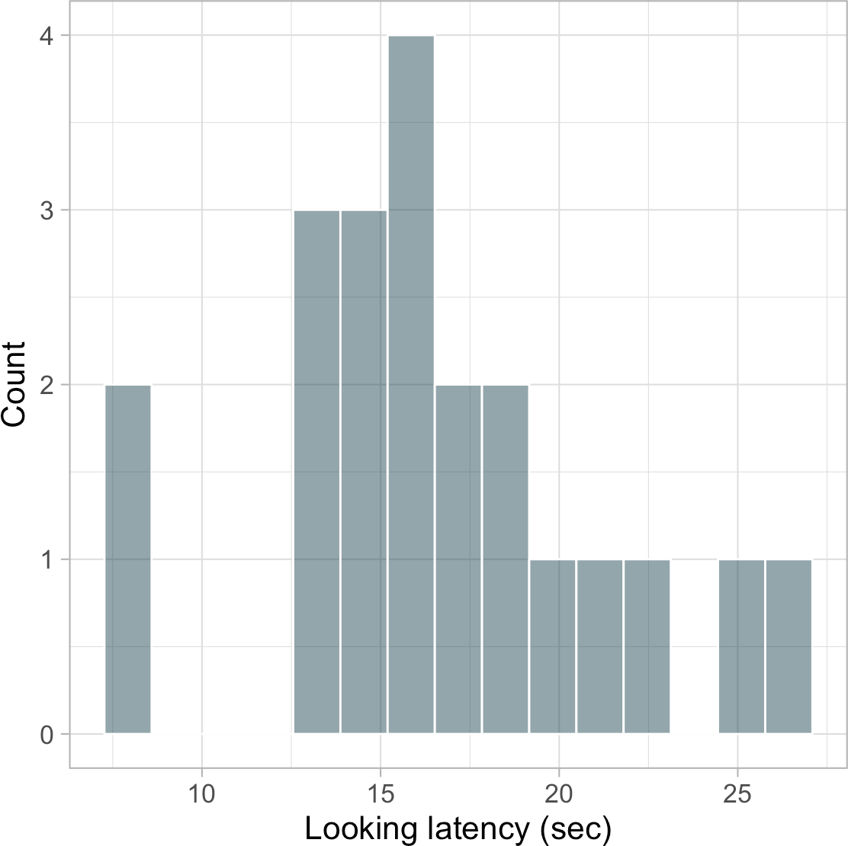
The mean, the median and the mode
Measures of central tendency:
Mean: the average value ^{∑ xi}
n
Median: the value exactly in the middle
Mode: the most common value

Slide 21
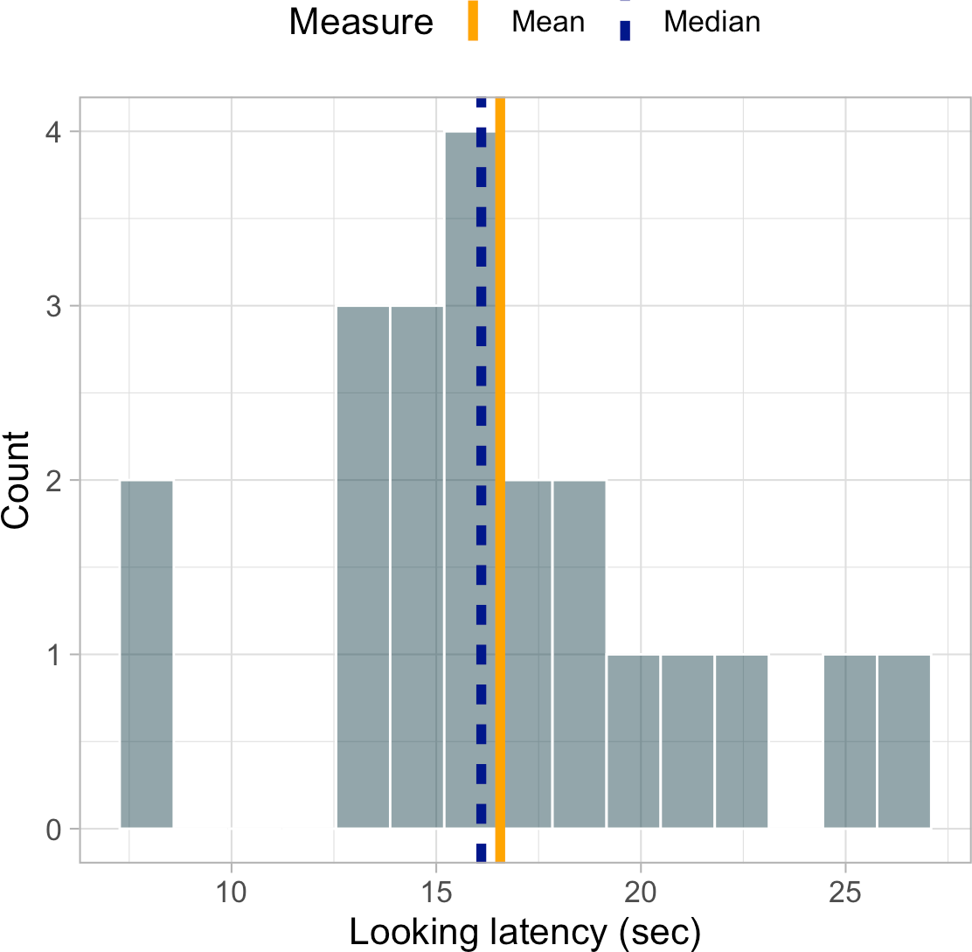
The mean, the median and the mode
Measures of central tendency:
Mean: the average value ^{∑ xi} = 16.56
n
Median: the value exactly in the middle = 16.1
Mode: the most common value (around 15)

Slide 22
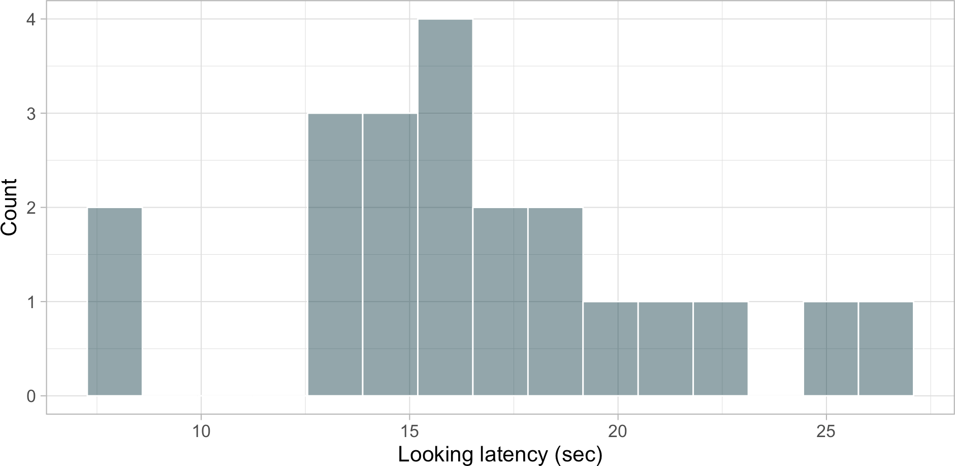
Variance
2
Variance - how scores differ from each other ^{∑ (Xi −X)}
. Alternatively:
n−1
1 var(cat_sample$look_latency)
[1] 22.17848

Slide 23
Variance
√
∑ (X −X)
2
Standard deviation - on average, by how much do scores differ from the mean?
i
. Alternatively:
n−1
sd_sample <- sd(cat_sample$look_latency)
sd_sample
[1] 4.709403

Slide 24
Unusual cases?
Given our sample, how unusual is a cat who took longer than 25 seconds to look at their owner
1 nrow(cat_sample)
[1] 21
There are 21 cats in our sample
dplyr::filter(
cat_sample,
look_latency > 25
4 )
cat_name
look_latency
Bubbles
25.3
Commodore
2 cats out of 21 represents a proportion of 2/21 = 0.095.
25.9
The empirical probability that a cat takes more than 25s to look at owner is 0.095, or 9.5 percent.

Slide 25

Populations vs samples
Sample =/= Population
Population distribution
Sample distribution
Describes the frequency with which scores of a variable occur in the population.
Describes the frequency with which scores of a variable occur in the sample.
Two cornerstones of statistical research:
A distribution of a sample from a given population will resemble the shape of that population.
A lot of variables have population distributions with a predictable shape.

Slide 26
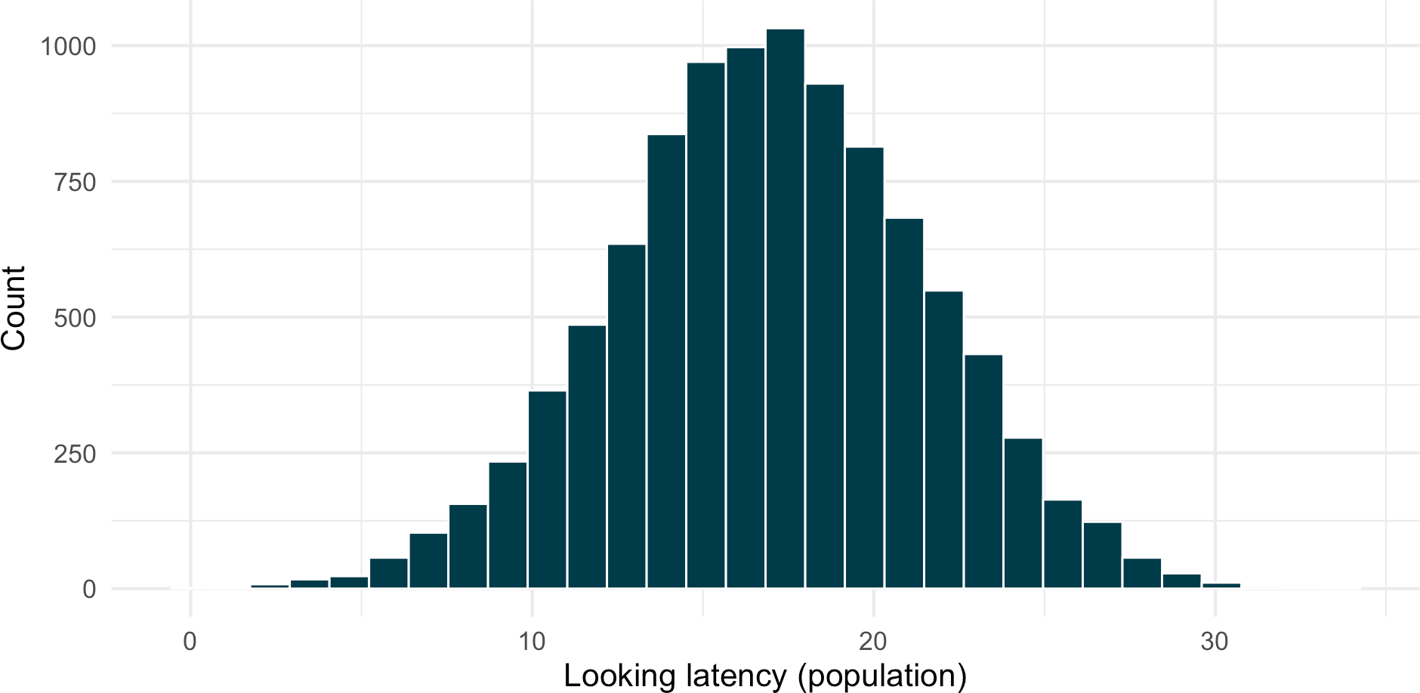
Populations vs samples
1. A distribution of a sample from a given population will resemble the shape of that population.
The larger our sample, the closer it will resemble the population distribution.

Slide 27
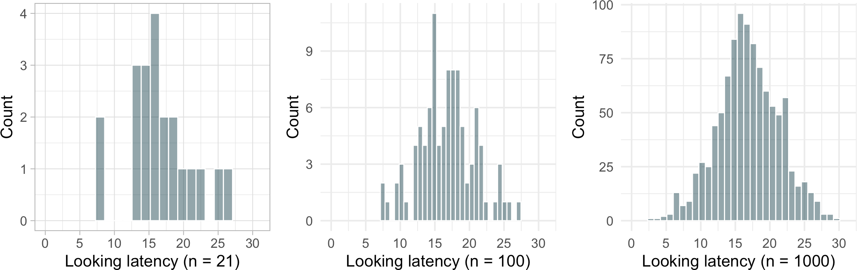
Populations vs samples
1. A distribution of a sample from a given population will resemble the shape of that population.
The larger our sample, the closer it will resemble the population distribution.

Slide 28
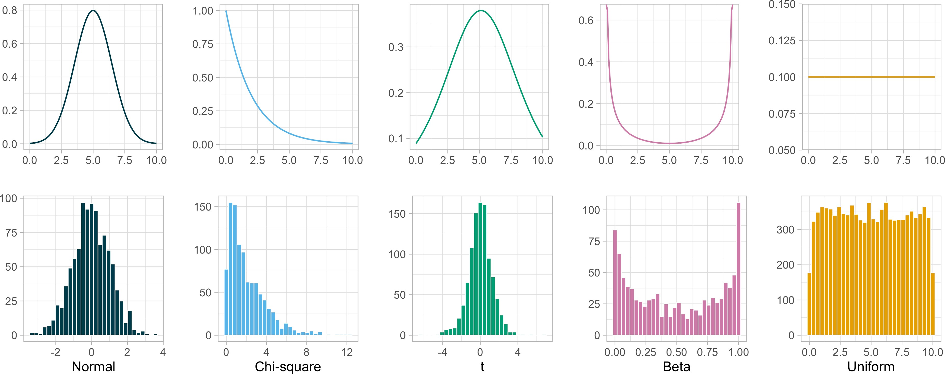
Known distributions
2. A lot of variables have population distributions with a predictable shape.

Slide 29
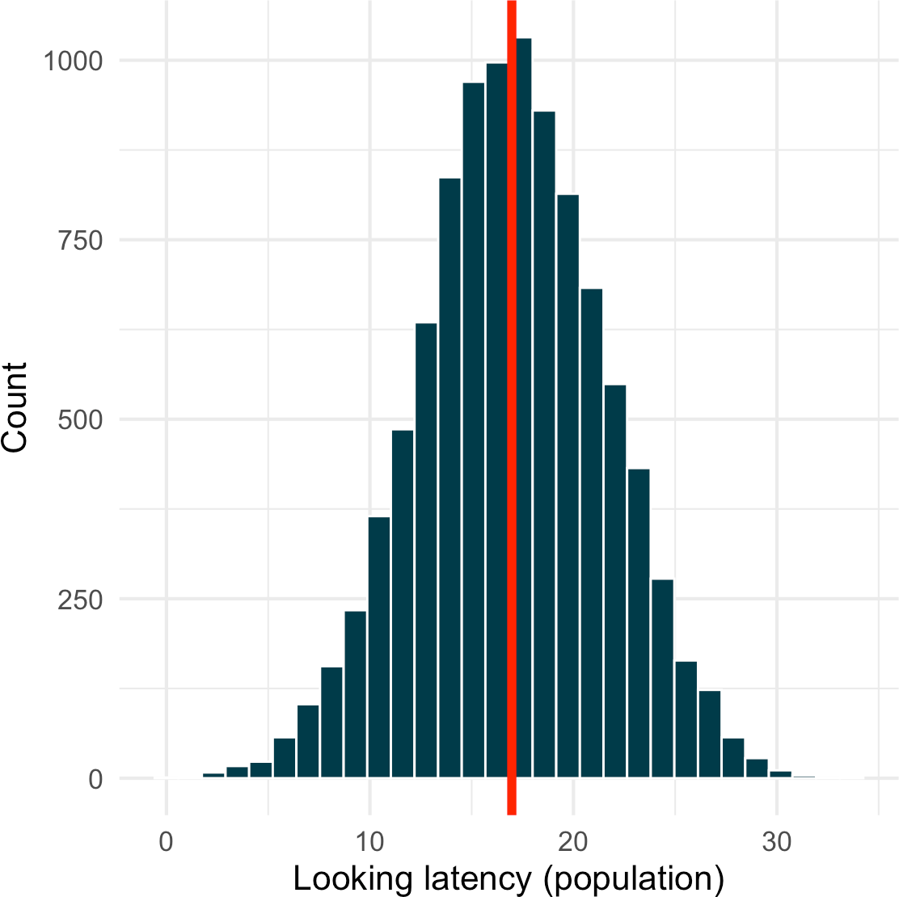
One shape to rule them all
Normal distribution is : Symmetrical (skewness of 0) Bell-shaped
Unimodal (only has one mode)
Defined by mean and standard deviation
Mean, median, and mode converge on one value

Slide 30
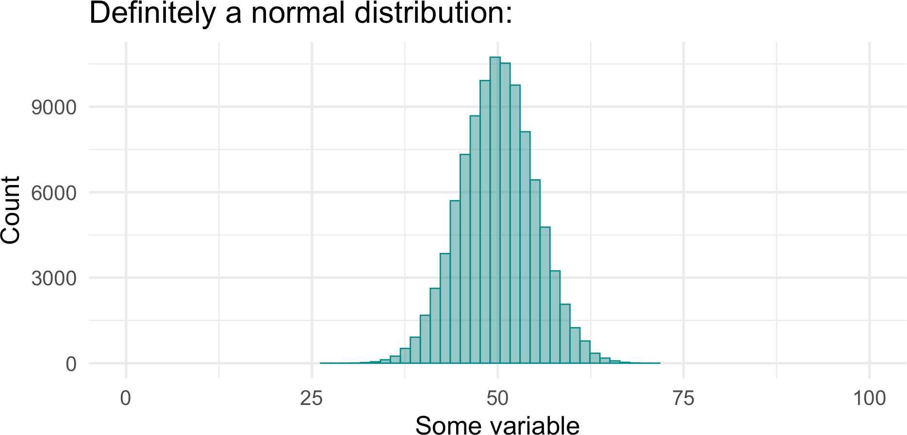
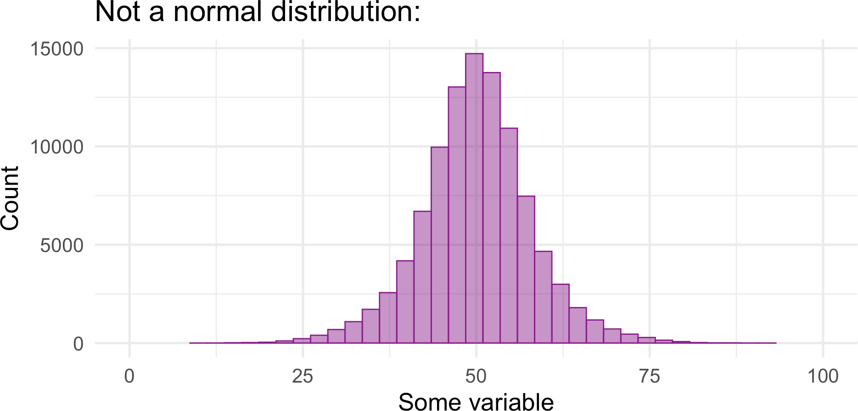
Sneaky distributions
There are infinite possible combinations of means and standard deviations Therefore there are infinite possible normal distributions
But not every bell-shaped distributions is a normal distribution
Proportions matter

Slide 31
How to tell whether something is actually normally distributed
We know that normal distribution has: More scores in the middle
Fewer and fewer scores in the tails, the further away we get from the mean - the centre of the distribution
Proportions matter
We expect certain proportions of scores at certain distances away from the mean:
~68% of scores will be within 1 standard deviation of the mean
~95% of scores will be within 1.96 standard deviations of the mean
~99% of scores will be within 2.58 standard deviations of the mean

Slide 32
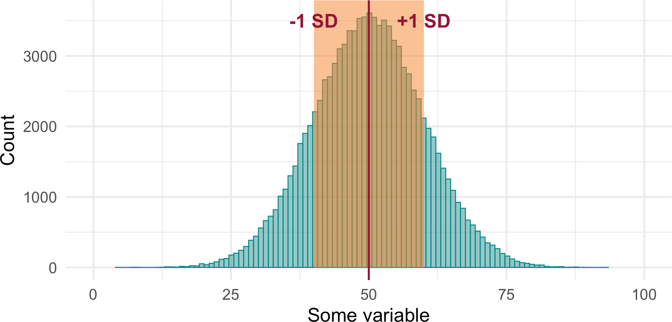
How to tell whether something is actually normally distributed
~68% of scores will be within 1 standard deviation of the mean:
This means that shaded area contains approximately ~68% of the scores.

Slide 33
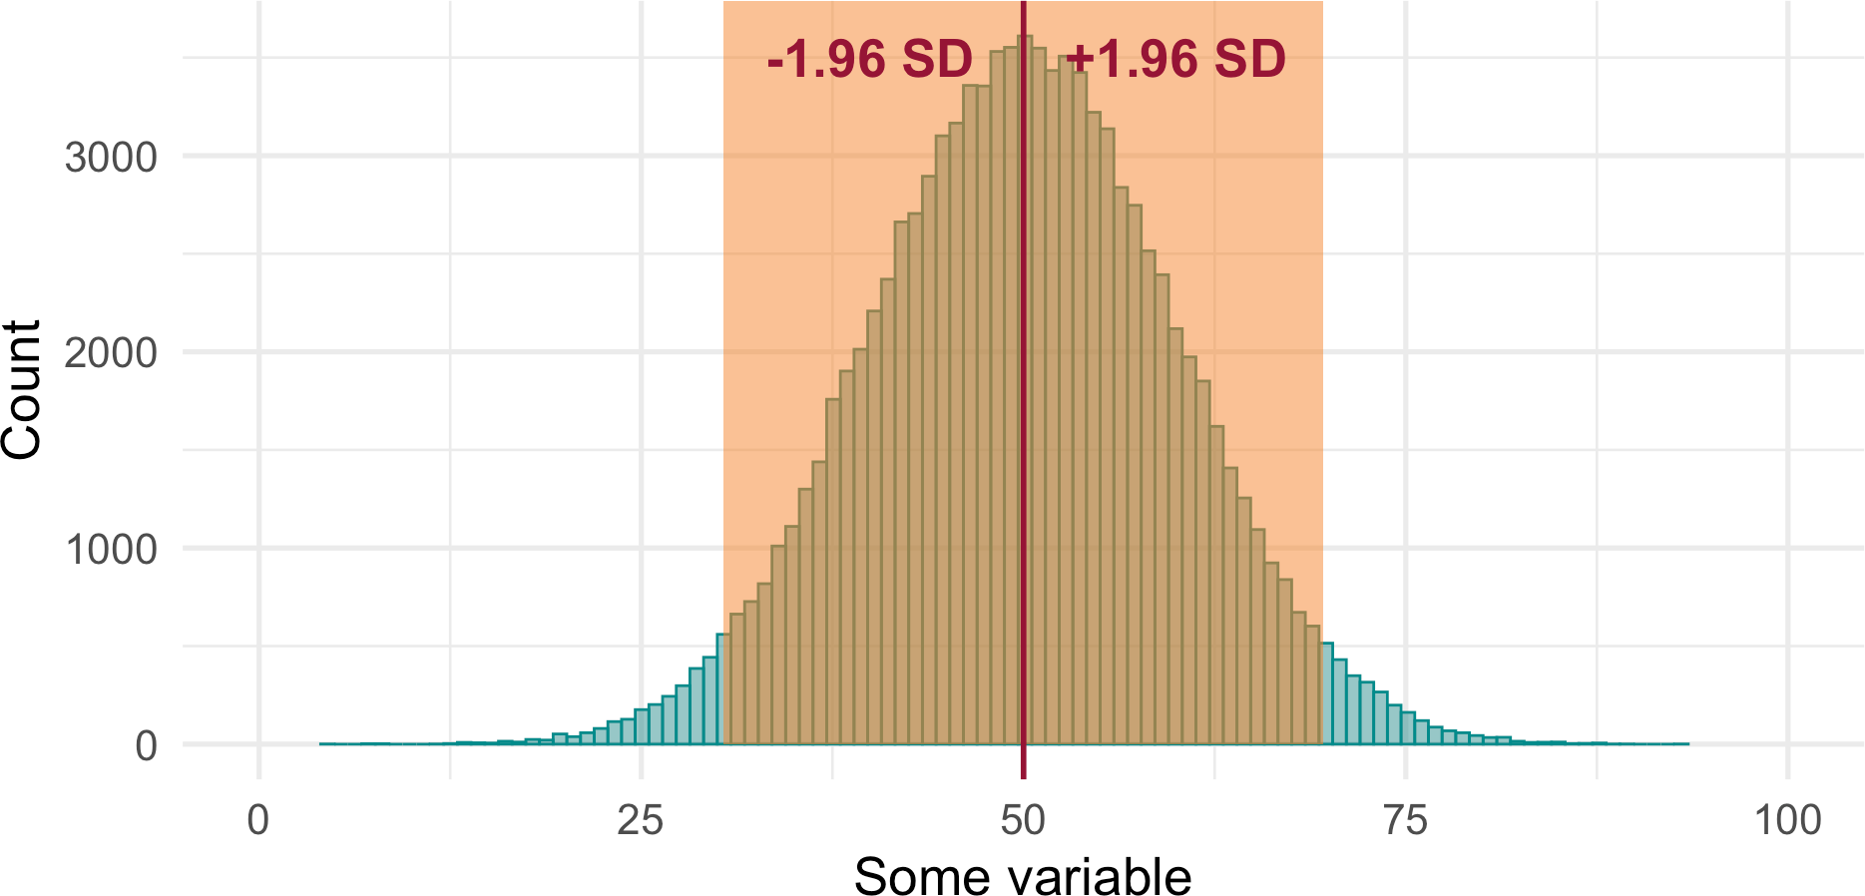
How to tell whether something is actually normally distributed
~95% of scores will be within 1.96 standard deviations of the mean:
This means that the shaded area contains approximately ~95% of the scores.

Slide 34
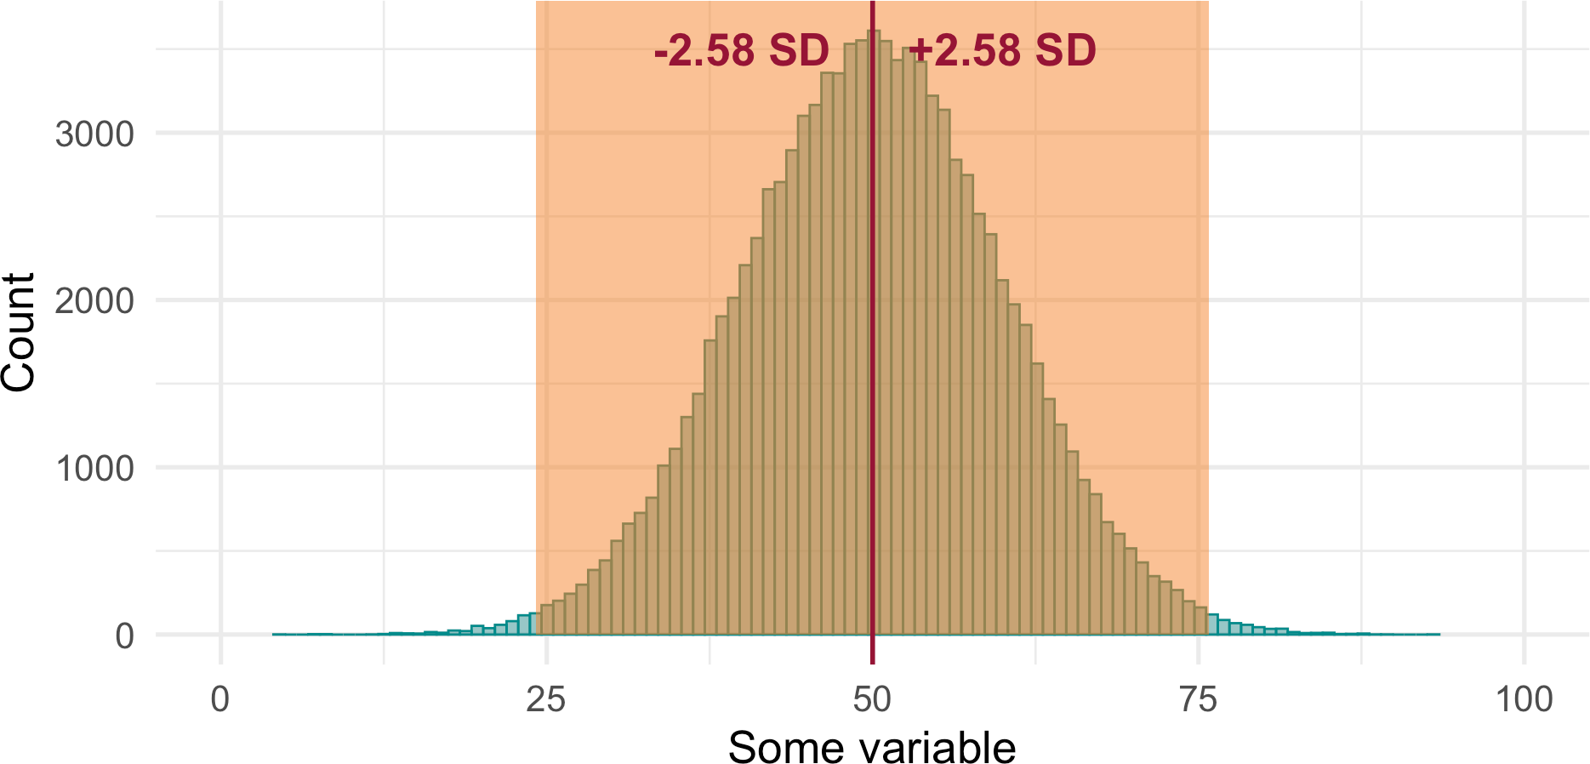
How to tell whether something is actually normally distributed
~99% of scores will be within 2.58 standard deviations of the mean:
This means that the shaded area contains approximately ~99% of the scores. The remaining <1% will be a the unshaded tails.
36

Slide 35
Z-scores

Slide 36
Z-scores
A way of assessing how unusual/uncommon a score is with reference to the mean
Mean of our sample: 16.56 SD sample: 4.71
X − M
Z =
SD
We are converting scores into standard deviation units.

Slide 37

Z-scores - what’s “unusual”?
Dracula is a cat from our sample
Dracula only spent 7 seconds on a task before turning to his owner
Is Dracula unusual?

Slide 38
Z-scores - what’s “unusual”?
Calculate Dracula’s Z-score:
X − M
Z =
SD
7 − 16.56
Z =
4.71
Z = −2.03
Dracula’s looking latency is 2.03 standard deviations smaller than the mean.

Slide 39
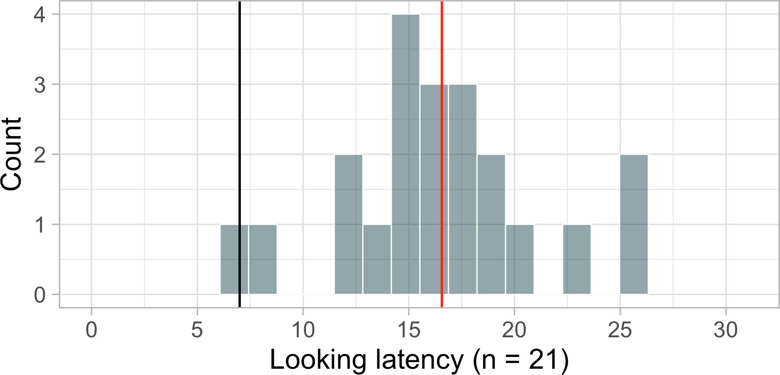
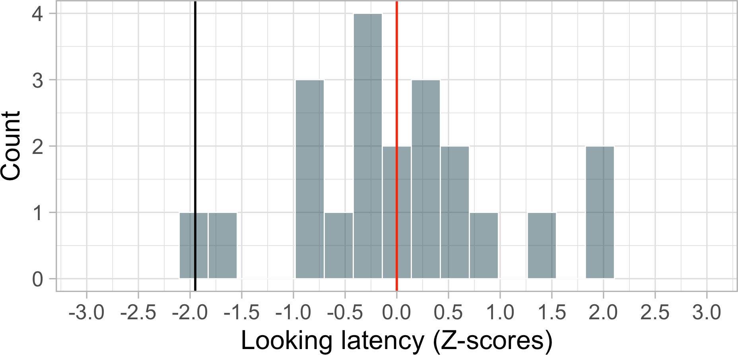
Z-scores - what’s “unusual”?
We can convert the whole sample into Z-scores:
Standardisation - the shape of the distribution remains the same but mean and SD change.
Mean = 0
SD = 1

Slide 40
Z-scores - what’s “unusual”?
We can convert the whole sample into Z-scores:
Standardisation allows us to work with probabilities:
~68% of scores will be within Z-scores of -1 to +1
~95% of scores will be within Z-scores -1.96 to + 1.96
~99% of scores will be within Z-scores -2.58 to + 2.58

Slide 41
Z-scores - what’s “unusual”?
We can convert the whole sample into Z-scores:
Standardisation allows comparisons:
Across measurement scales
Accounting for the characteristics of a normal distribution With reference to the population

Slide 42
Critical Values

Slide 43
Unusual in a population…
Problem: we don’t know what the population looks like - i.e. what is the mean and the SD? We can assume a standard normal population distribution
Simplest normal distribution - makes minimal assumptions:
μ = 0 (population mean)
σ = 1 (population SD)
A distribution of Z-scores from a sample can be (1) compared against a standard normal population distribution (2) calculate the probability of a score based on standard deviation expectations.
This allows us to quantify whether something “unusual” or “surprising” with reference to the population.

Slide 44
Is Dracula a strange cat?
Place Dracula’s score on a standard normal distribution
Workout the probability of the shaded area
Compare against some defined “unusualnes” cut-off

Slide 45
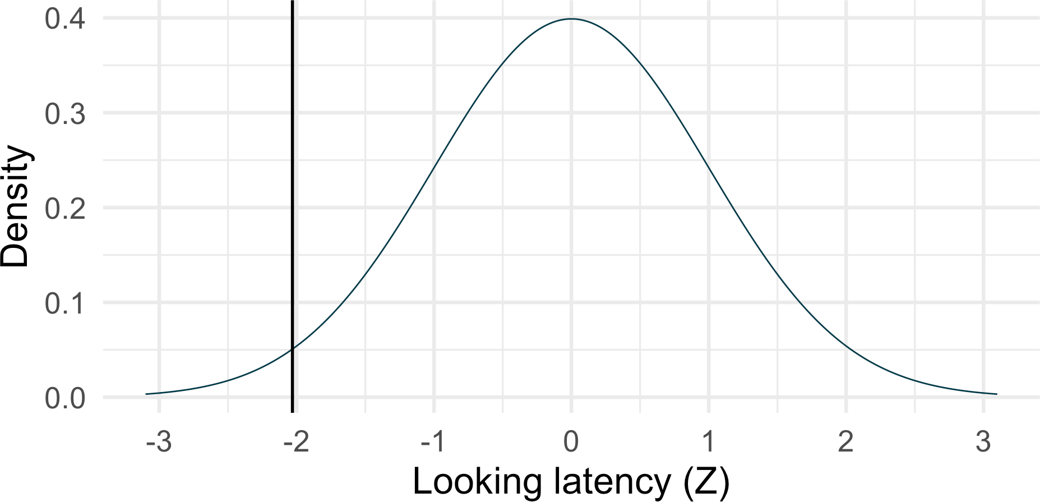
Is Dracula a strange cat?
1. Place Dracula’s score on a standard normal distribution

Slide 46
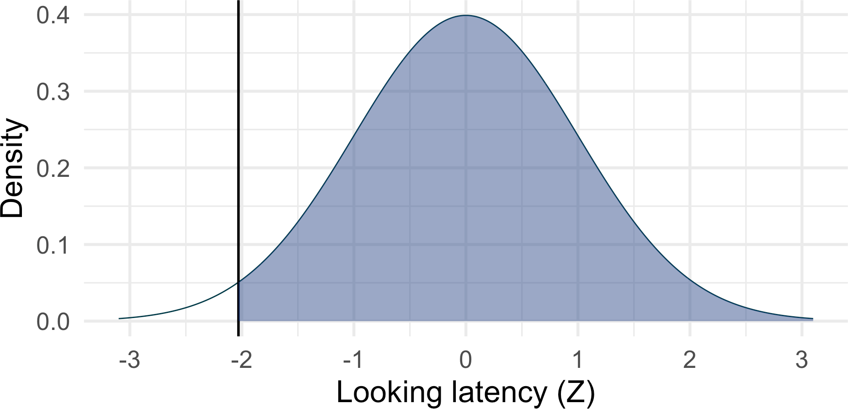
Is Dracula a strange cat?
2. Workout the probability of the shaded area
Shaded area: proportion of the cat population that spend more time on a task than Dracula

Slide 47

Is Dracula a strange cat? Working out probabilities
2. Workout the probability of the shaded area
Option 1: Use a “Z-table” - ancient tablets from the 1800 BC. Pre-calculated and printed in special books or at the end of textbooks.

Slide 48
Option 1: Z-tables
A table of probabilities associated with Z-scores
0.00 |  | 0.01 | 0.02 | 0.03 | 0.04 | 0.05 | 0.06 | 0.07 | 0
0.0 | 0.50000 | 0.50399 | 0.50798 | 0.51197 | 0.51595 | 0.51994 | 0.52392 | 0.52790 | 0.531
0.1 | 0.53983 | 0.54380 | 0.54776 | 0.55172 | 0.55567 | 0.55962 | 0.56356 | 0.56749 | 0.571
0.2 | 0.57926 | 0.58317 | 0.58706 | 0.59095 | 0.59483 | 0.59871 | 0.60257 | 0.60642 | 0.610
0.3 | 0.61791 | 0.62172 | 0.62552 | 0.62930 | 0.63307 | 0.63683 | 0.64058 | 0.64431 | 0.648
0.4 | 0.65542 | 0.65910 | 0.66276 | 0.66640 | 0.67003 | 0.67364 | 0.67724 | 0.68082 | 0.684
0.5 | 0.69146 | 0.69497 | 0.69847 | 0.70194 | 0.70540 | 0.70884 | 0.71226 | 0.71566 | 0.71

Slide 49
Option 1: Z-tables
X − Mean
7 − 16.56
Z =
=
= −2.04
SD
4.71
Z-scores
0.04
2.0
0.97932

Slide 50
Is Dracula a strange cat?
2. Workout the probability of the shaded area
Option 1: Z-tables
Probability of a score from the shaded area: 0.97932
Probability of a score from the non- shaded area: 1 - 0.97932 = 0.02068 (a little over 2%)

Slide 51
Is Dracula a strange cat? Working out the probability
Option 2: Modern technology
1 pnorm(-2.04, lower.tail = FALSE)
[1] 0.9793248
Shaded area: 0.9793248 or 97.93%
Unshaded area: 0.0206752 or 2.07%
Assuming our cat population comes from a normal distribution, there’s only
0.021 probability (or 2.07%) of finding a cat like Dracula. He’s quite unusual!

Slide 52
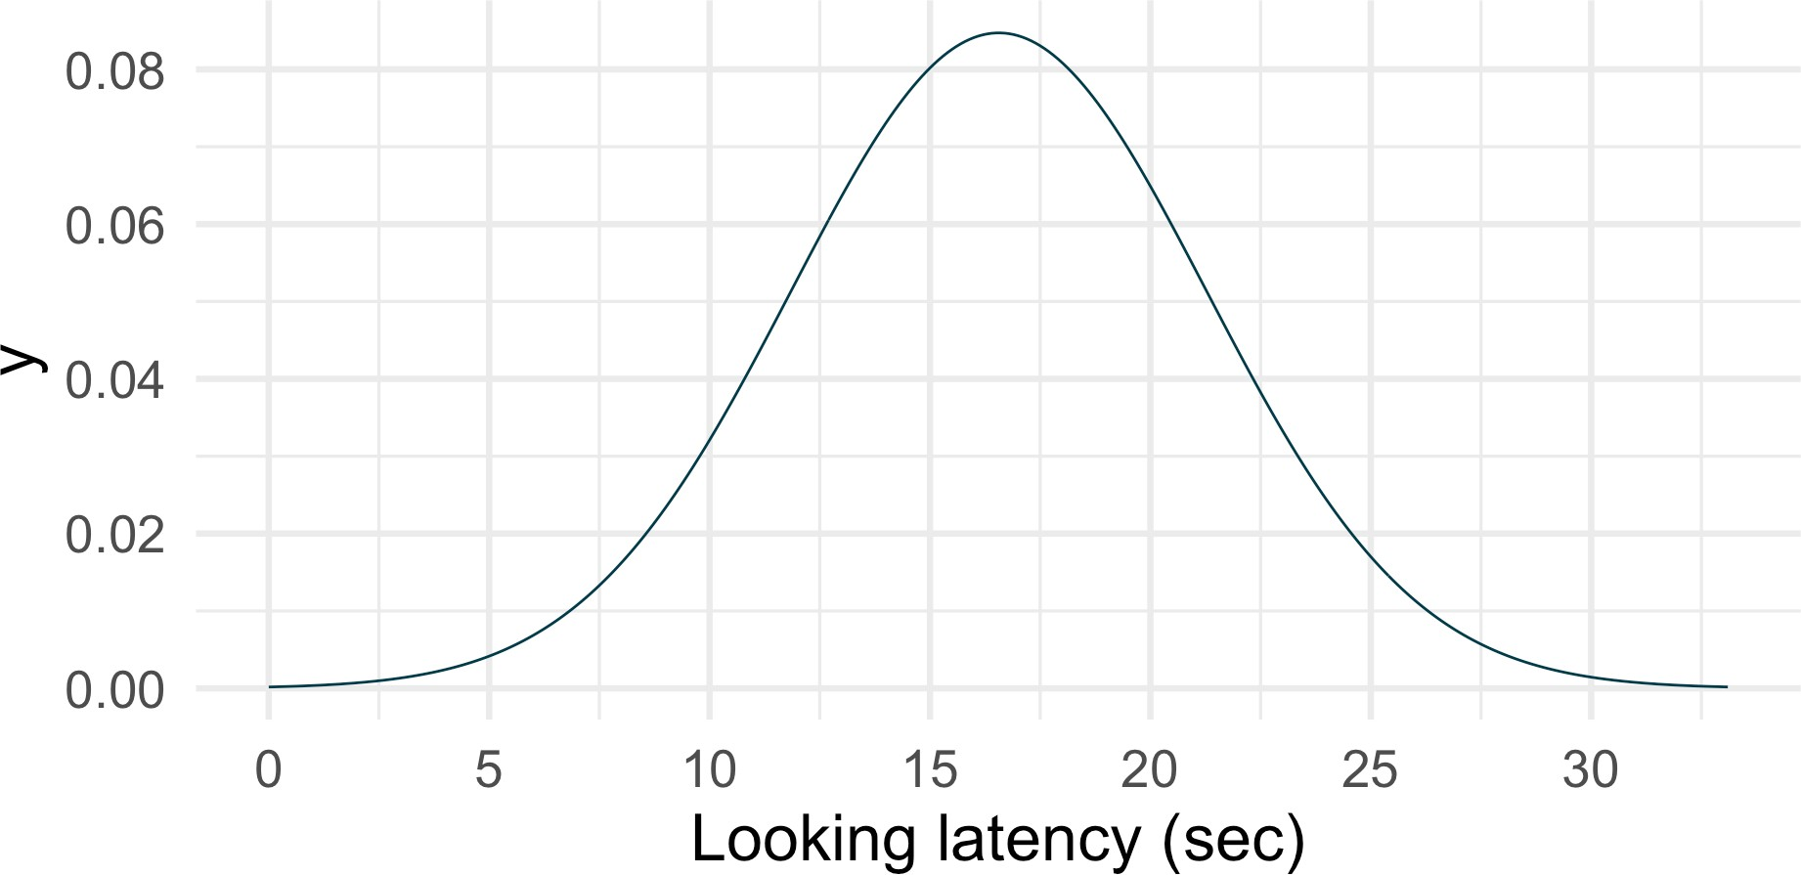
Another example
Oreo looked at his owner after 22.8 seconds. Is Oreo unusual - e.g. in the top 5% ? 👍 👎

Slide 53
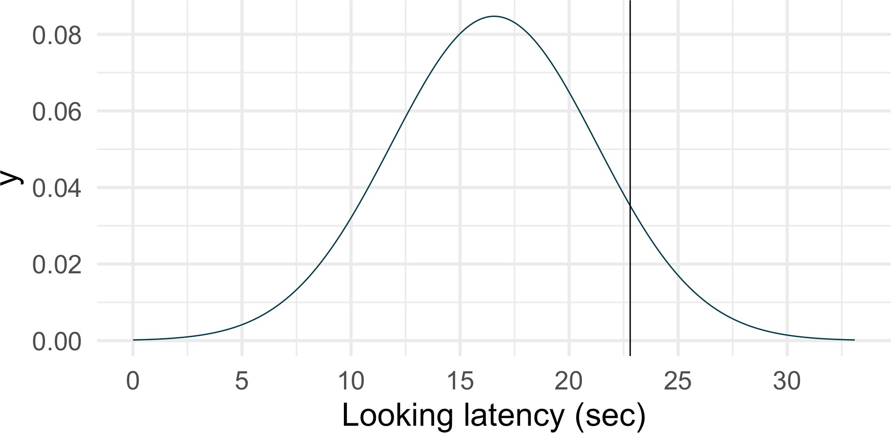
Another example
Oreo looked at his owner after 22.8 seconds. Is Oreo unusual - e.g. in the top 5% ? 👍 👎

Slide 54
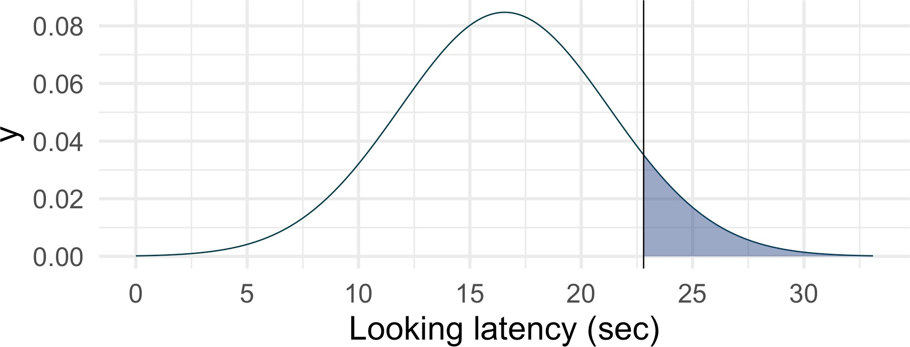
Another example
1 pnorm(22.8, mean = 16.6, sd = 4.7, lower.tail = FALSE) # we can skip manual Z-score convers
[1] 0.09355966
Shaded area: 0.094 or 9.36%
Unshaded area: 0.906 or 90.64%

Slide 55
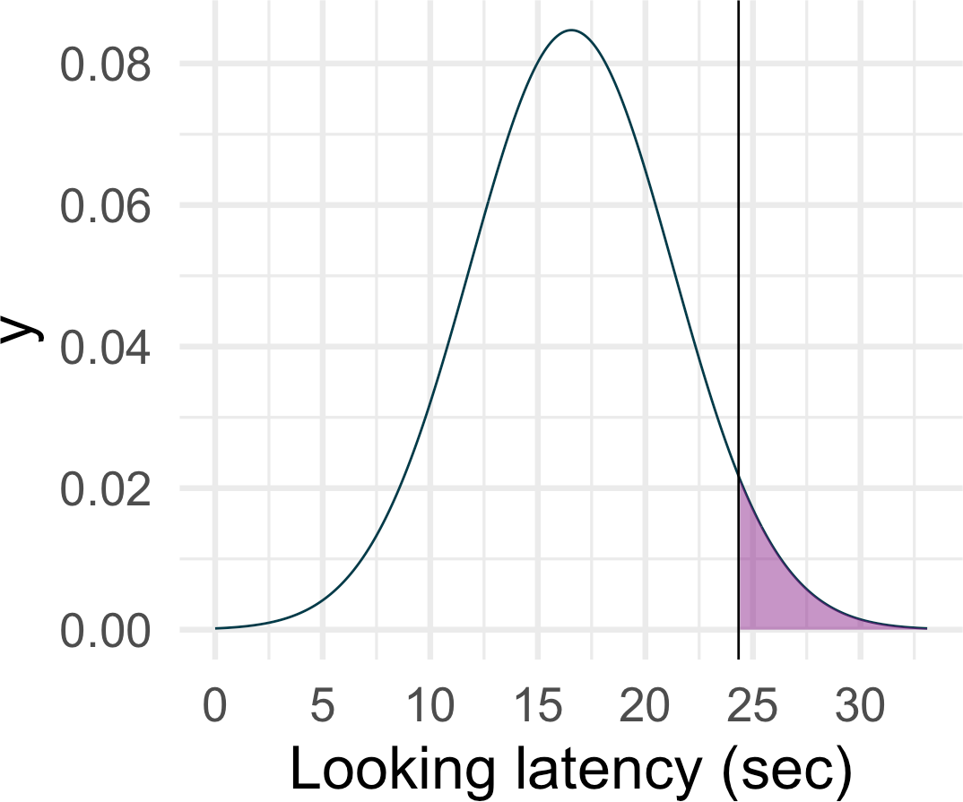
The other way around …
What is the critical value cutting-off top 5%?
We can reverse the math (or use a different R function) and calculate a critical cut-off for a specific probability, assuming some population mean and SD:
1 qnorm(p = 0.05, mean = 16.6, sd = 4.7,
[1] 24.33081
Decide in advance (e.g. top 5%, top 10%, etc…), then compare scores against this cut-off
3. Compare against some defined “unusualnes” cut- off

Slide 56
The other way around …
Researcher is interested in cats that spent the longest on the puzzle. He calculates the critical cut-off point for top 10% of looking latency as 22.62. He then identifies two cats. Goose, who spent 19.45 seconds on the task, and Pringles who spent 22.90 seconds on the task.
Are Goose and Pringles in the top 10%?

Slide 57
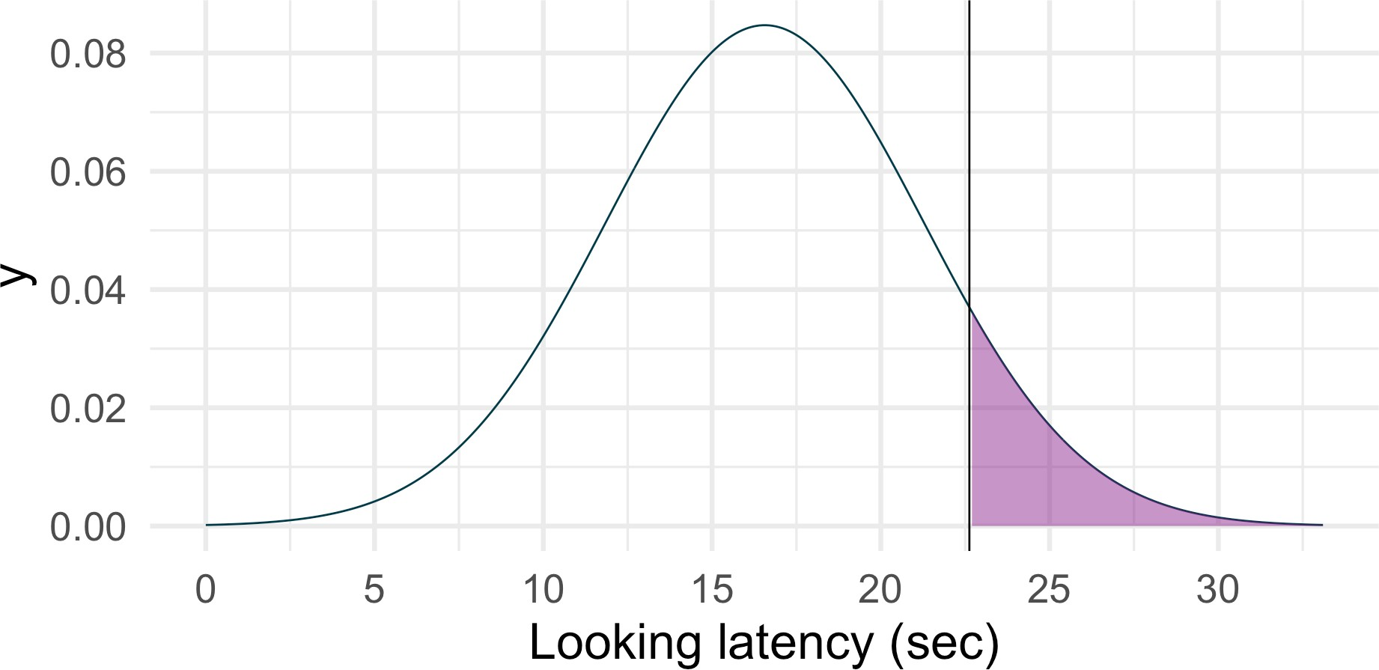
The other way around …
Goose: 19.45 seconds
Pringles: 22.90 seconds Critical cut-off: 22.62 👍👎

Slide 58
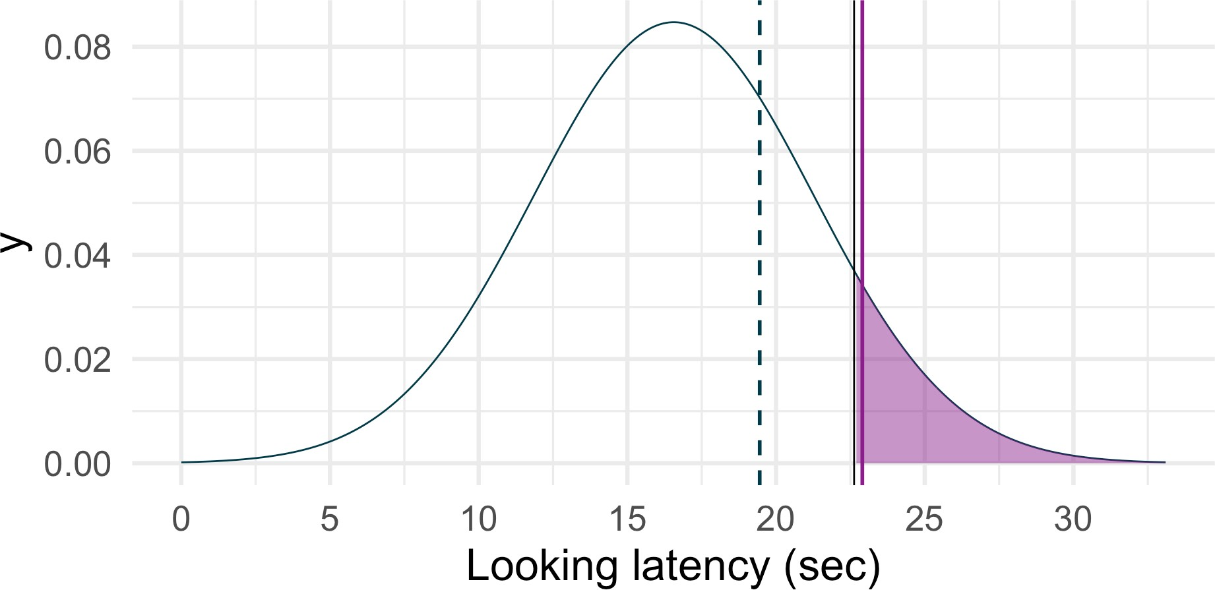
The other way around …
Goose: 19.45 seconds
Pringles: 22.90 seconds Critical cut-off: 22.62 👍👎

Slide 59
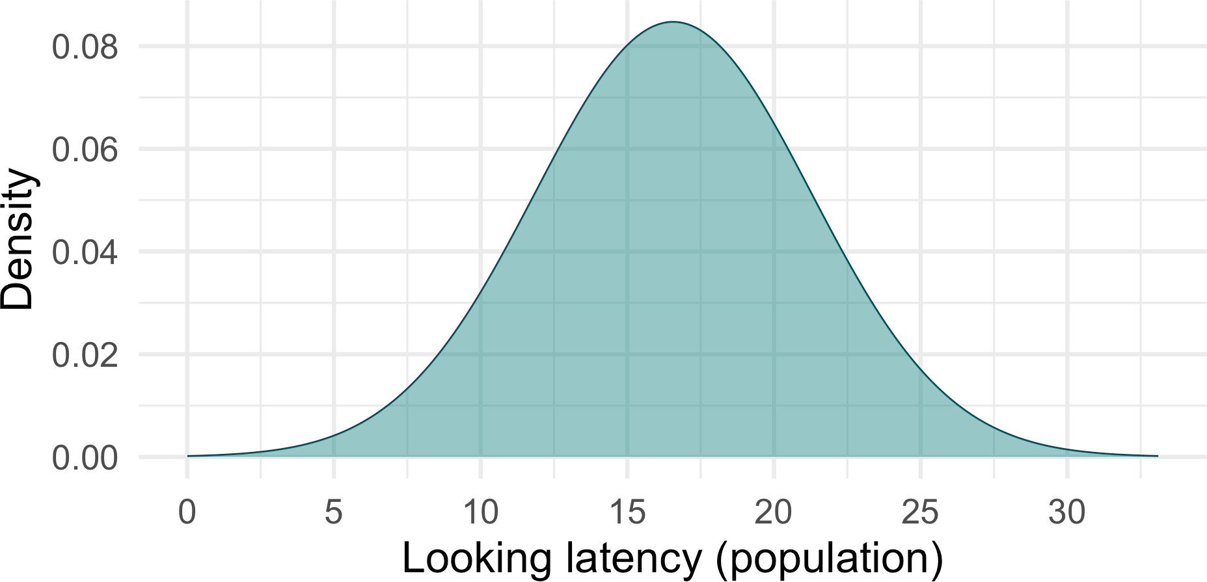
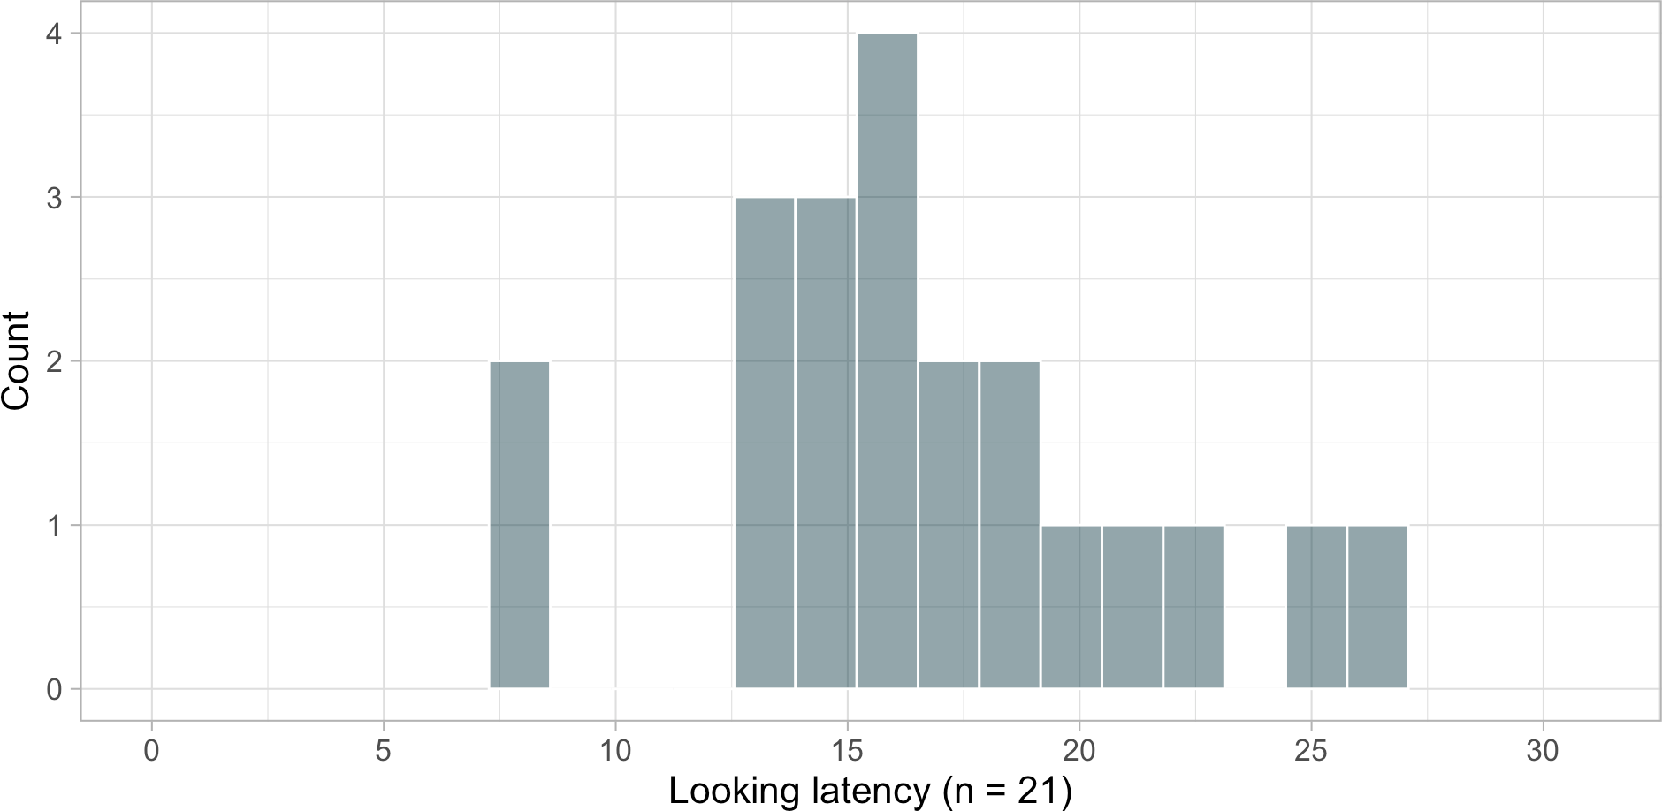
Assuming that…
We calculated these probabilities assuming a certain shape of the population distribution - we don’t know whether this assumption is reasonable.

Slide 60

Summary
Samples resemble populations - larger samples resemble them better
This allows us make assumptions about what the population looks might look like and calculate probabilities.
We assume some version of the reality (the population) and then we check whether what we observed is sufficiently unusual/interesting in this version of the reality.
Comparing against a pre-decided critical cut-off from some population distribution is a core principle in hypothesis testing - more in the weeks to come.
NEXT WEEK:
Quantifying uncertainty with standard errors and confidence intervals

Slide 61
References
Forman, Jemma, and David Leavens. 2024. “The Effect of Transparency on Unsolvable Task Engagement in Domestic Cats (Felis Catus) Using Citizen Science.” http://dx.doi.org/10.21203/rs.3.rs-3834933/v1.

